Slide 1
PATOLOGIA PSICHIATRICA E CHIRURGIA BARIATRICA: IL PROBLEMA DELLA TERAPIA FARMACOLOGICA
Dott.ssa Paola Landi
Medico Psichiatra Asst Fatebenefratelli-Sacco, Milano
Dr. Gabriele Pezzullo
Medico Specializzando Psichiatria Asst Fatebenefratelli- Sacco, Milano

Slide 2
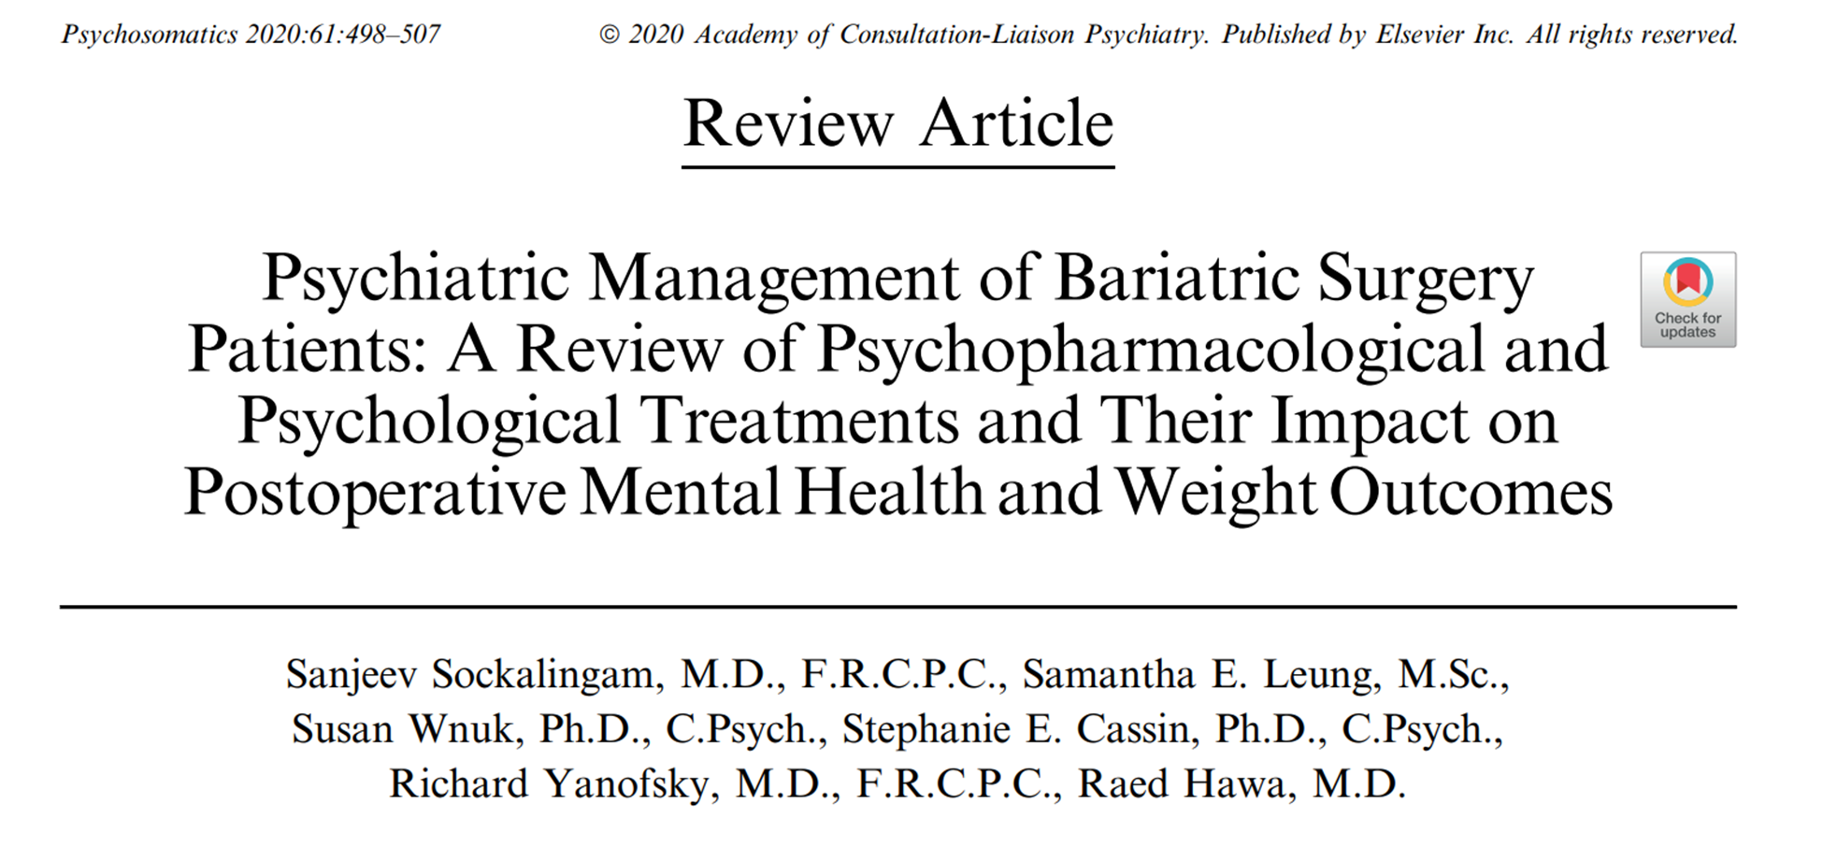

Slide 3
I farmaci psicotropi sono tra i farmaci più frequentemente prescritti nei pazienti che vengono sottoposti ad interventi di chirurgia bariatrica
gli antidepressivi che rappresentano la classe maggiormente usata
Il 35%–38% dei canditati alla chirurgia bariatrica assumono farmaci psicotropi prima dell’intervento.
Uno studio retrospettivo di 439 pazienti che sono stati operati con un RYGB ha visto che:
-Il 23% dei pazienti ha aumentato il dosaggio dell’ antidepressivo
-Il 40% ha continuato a necessitare dello stesso antidepressivo
-Il 18% ha avuto un cambiamento del farmaco antidepressivo
-Il 16% ha avuto una diminuzione del dosaggio o ha interrotto il proprio antidepressivo.
Notes:
‘’Psychiatric Management of Bariatric Surgery Patients: A Review of Psychopharmacological and Psychological Treatments and Their Impact onPostoperative Mental Health and Weight Outcomes’’

Slide 4
Le procedure bariatriche comportano cambiamenti anatomici e fisiologici e modificano la biodisponibilità dei farmaci
Le alterazioni farmacocinetiche possono potenzialmente alterare l’efficacia terapeutica e/o aumentare il rischio di effetti collaterali
Notes:
PsychiatricManagement of Bariatric Surgery Patients: A Review of Psychopharmacological and Psychological Treatments and Their Impact onPostoperative Mental Health andWeightOutcomes

Slide 5
Le sfide relative al trattamento farmacologico psichiatrico dopo l'intervento richiedono una migliore comprensione della:
1) farmacocinetica
2) dell’impatto dei farmaci psichiatrici sulla perdita di peso
3) dei sintomi psichiatrici dopo l’intervento

Slide 6
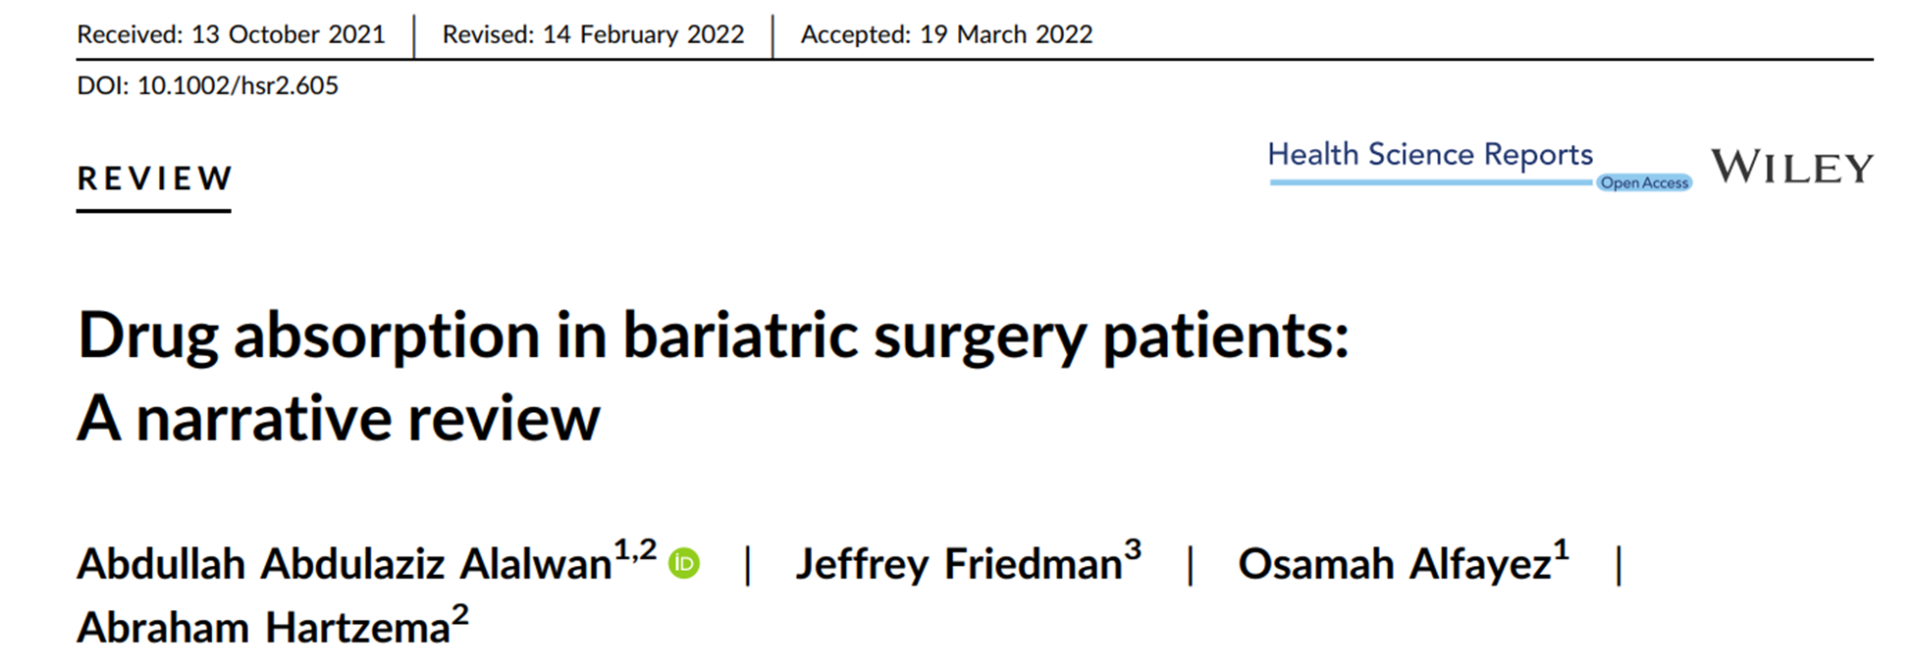
Farmacocinetica
Notes:
The type of surgery also plays an important role, with the RYGB procedure being more likely to affect the absorption of drugs, due to changes in mucosal
exposure and decreased bile-salt mixing.
For restrictive surgeries, changes in absorption are a secondary effect of shortened gastric transit times, while malabsorptive procedures directly alter this via
resection of the duodenum and upper jejunum, where some of this uptake would otherwise occur.
‘’Drug absorption in bariatric surgery patients: A narrative review’’

Slide 7
Farmacocinetica
Questi cambiamenti delle proprietà farmacocinetiche e farmacodinamiche sono legati alle alterazioni anatomiche causate dagli interventi di chirurgia bariatrica, tipicamente classificati in:
Restrittivi
Malassorbitivi
Restrittivi e Malassorbitivi
Notes:
The type of surgery also plays an important role, with the RYGB procedure being more likely to affect the absorption of drugs, due to changes in mucosal
exposure and decreased bile-salt mixing.
For restrictive surgeries, changes in absorption are a secondary effect of shortened gastric transit times, while malabsorptive procedures directly alter this via
resection of the duodenum and upper jejunum, where some of this uptake would otherwise occur.

Slide 8
Farmacocinetica
Perché questi cambiamenti avvengono?
Resezione gastrica aumenta il Ph gastrico
resezione o bypass delle aree deputate all’assorbimento
Riduzione dei trasportatori
Insufficiente tempo di transito
alterata secrezione degli acidi biliari
limitata assunzione di liquidi nel post-operatorio
Notes:
Gastric restriction decreases the amount of hydrochloric acid secreted and increases the gastric pH, leading to poor disintegration, dissolution, and absorption of acid‐soluble drugs.
Bariatric procedures that involve resection or bypass of the absorptive areas of the duodenum and proximal jejunum affect the dissolution and absorption of drugs due to a decrease in the surface areas for intestinal absorption.
Renal function and renal clearance may be impaired in obesity furthermore, fluid intake post-surgery is limited, therefore reducing the excretion and increasing the exposure of the affected drugs
The secretion of the bile acids is impaired by the bypass procedure, which may lead to the incomplete dissolution and absorption of lipophilic drugs
The reduction in transporters that function as carriers of drug particles across the intestine lumen to the circulation can lead to low bioavailability of drugs.
The bypassing of portions of the gastrointestinal system gives the extended-release drugs an insufficient transit time to reach full absorption.

Slide 9
Farmacocinetica
Questi cambiamenti potrebbero essere temporanei:
Miglioramento della funzionalità epatica
Ipertrofia della mucosa
Notes:
These changes might be temporary , one study has examinated serum levels of SRI showing a significant improvement in absorption ifter 12 month
- significant weight loss caused by the surgery will improve the liver function.
- Other studies showed a mucosal hypertrophy after bariatric surgery

Slide 10
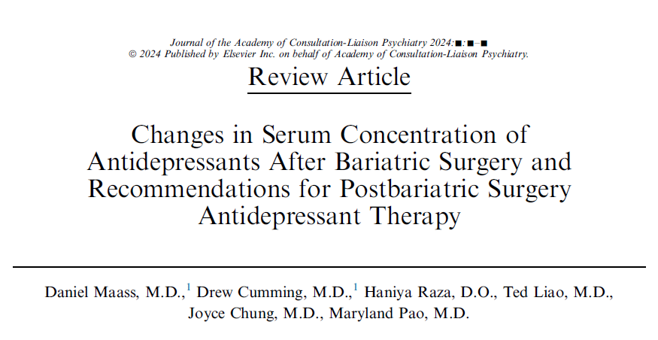
Antidepressivi
Notes:
‘’Changes in serum concentration of antidepressants after bariatric surgery and recommendations for postbariatric surgery antidepressant therapy’’

Slide 11
Antidepressivi
Riduzione significativa dei livelli plasmatici di:
sertralina, duloxetina, trazodone e vortioxetina tra le due settimane e un anno dopo RYGB
Paroxetina, escitalopram, bupropion, e fluoxetina sono associati a cambiamenti variabili delle concentrazioni plasmatiche successivamente ad RYGB
Nessuna alterazione significativa è stata riscontrata per venlafaxina, amitriptilina o clomipramina
Notes:
This comprehensive review showed that analyzed various studies present in literature
Escitalopram, sertraline and venlafaxine were the most commonly
studied medications however, two of the larger studies, Hamad et al. 201216 and Pasi et al.,22 pooled results for all tested medications limiting the impact o their findings.
Paroxetine is problematic by virtue of its unfavorable dissolution profile both at baseline and under in vitro conditions; given its comparatively short half-life, patients would likely be at higher risk for large diurnal variations in serum levels and discontinuation syndrome. Curiously, the one patient taking paroxetine in Wallerstedt et al.20 had markedly increased serum levels following surgery
Of the medications examined, venlafaxine has the best in vivo data along with good in vitro measurements of dissolution in the post-RYGB environment and a favorable baseline dissolution/absorption profile. This results are consistent regardless of the formulation
Citalopram has favorable pharmacological properties and good in vitro dissolution data; the work of Wallerstedt et al.20 suggests that serum levels may be modestly lower
following bariatric surgery, but this should be interpreted with caution given that these results were pooled with those of escitalopram.
As for escitalopram, Marzinkeet al. showed that serum levels decreased significantly in the months following surgery, while Schoretsanitis et al. suggested that these changes are
less pronounced 1-year postsurgery.

Slide 12
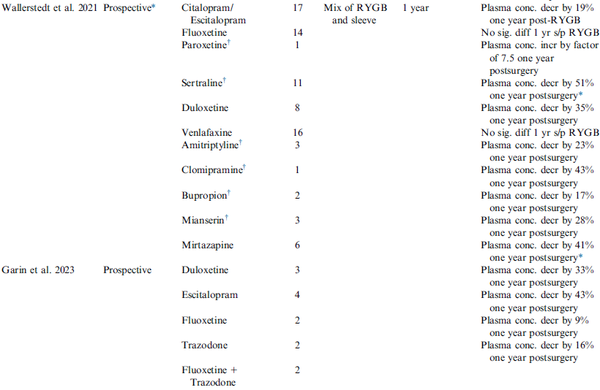
Antidepressivi
Notes:
This comprehensive review showed that analyzed various studies present in literature
Escitalopram, sertraline and venlafaxine were the most commonly
studied medications however, two of the larger studies, Hamad et al. 201216 and Pasi et al.,22 pooled results for all tested medications limiting the impact o their findings.
Paroxetine is problematic by virtue of its unfavorable dissolution profile both at baseline and under in vitro conditions; given its comparatively short half-life, patients would likely be at higher risk for large diurnal variations in serum levels and discontinuation syndrome. Curiously, the one patient taking paroxetine in Wallerstedt et al.20 had markedly increased serum levels following surgery
Of the medications examined, venlafaxine has the best in vivo data along with good in vitro measurements of dissolution in the post-RYGB environment and a favorable baseline dissolution/absorption profile. This results are consistent regardless of the formulation
Citalopram has favorable pharmacological properties and good in vitro dissolution data; the work of Wallerstedt et al.20 suggests that serum levels may be modestly lower
following bariatric surgery, but this should be interpreted with caution given that these results were pooled with those of escitalopram.
As for escitalopram, Marzinkeet al. showed that serum levels decreased significantly in the months following surgery, while Schoretsanitis et al. suggested that these changes are
less pronounced 1-year postsurgery.

Slide 13
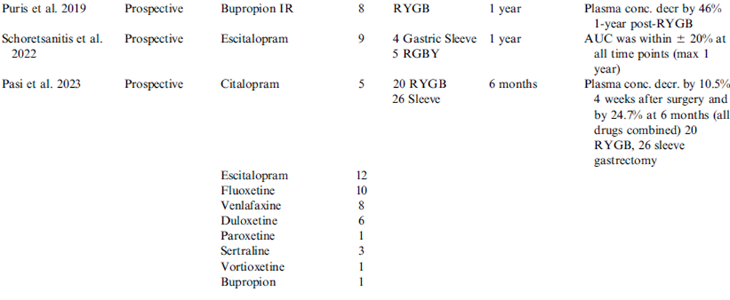
Antidepressivi
Notes:
This comprehensive review showed that analyzed various studies present in literature
Escitalopram, sertraline and venlafaxine were the most commonly
studied medications however, two of the larger studies, Hamad et al. 201216 and Pasi et al.,22 pooled results for all tested medications limiting the impact o their findings.
Paroxetine is problematic by virtue of its unfavorable dissolution profile both at baseline and under in vitro conditions; given its comparatively short half-life, patients would likely be at higher risk for large diurnal variations in serum levels and discontinuation syndrome. Curiously, the one patient taking paroxetine in Wallerstedt et al.20 had markedly increased serum levels following surgery
Of the medications examined, venlafaxine has the best in vivo data along with good in vitro measurements of dissolution in the post-RYGB environment and a favorable baseline dissolution/absorption profile. This results are consistent regardless of the formulation
Citalopram has favorable pharmacological properties and good in vitro dissolution data; the work of Wallerstedt et al.20 suggests that serum levels may be modestly lower
following bariatric surgery, but this should be interpreted with caution given that these results were pooled with those of escitalopram.
As for escitalopram, Marzinkeet al. showed that serum levels decreased significantly in the months following surgery, while Schoretsanitis et al. suggested that these changes are
less pronounced 1-year postsurgery.

Slide 14
Antidepressivi
In conclusione, ci sono evidenze preliminari che mostrano una riduzione delle concentrazioni di alcuni antidepressivi dopo gli interventi di chirurgia bariatrica
Questi risultati sono variabili tra gli antidepressivi e i dati preliminari suggeriscono che l'assorbimento possa migliorare col tempo.
È stato segnalato un rischio elevato di suicidio nei pazienti post chirurgia bariatrica rispetto ai controlli

Slide 15
Antidepressivi
Mantenere la collaborazione tra l’equipe chirurgica e psichiatrica
Trattare il paziente e stabilire la dose più efficace prima dell’intervento
Informare il paziente su potenziali peggioramenti dei sintomi psichiatrici
Usare scale standardizzate per valutare la gravità dei sintomi nel primo anno post-operatorio

Slide 16
Antidepressivi
5. Poiché la riduzione della biodisponibilità si verifica soprattutto nel primo mese dopo l’intervento chirurgico, la valutazione dei sintomi dovrebbe avvenire entro questo periodo. Si consigliano valutazioni ripetute a 3,6 e 12 mesi
6. Tutti i pazienti che assumono SSRI dovrebbero avere a disposizione i contatti per il trattamento psichiatrico di emergenza vicino alla loro zona di residenza.

Slide 17
Antidepressivi
7. In caso di ricorrenza dei sintomi psichiatrici, fornire supporto psicosociale durante il recupero e aumentare la biodisponibilità del farmaco utilizzando formulazioni che vengono assorbite più rapidamente come liquide, compresse triturabili o preparazioni a rilascio immediato.
8. Aumentare il dosaggio e/o dividere la dose in somministrazioni multiple e/o usare formulazioni transdermiche o intravenose.

Slide 18
Stabilizzatori dell’umore: litio
Gli effetti della chirurgia bariatrica sulla farmacocinetica degli stabilizzatori dell'umore sono ancora poco conosciuti.
Solo pochi studi hanno cercato di analizzare gli effetti di queste procedure su questa classe di farmaci
Un ridotto assorbimento degli stabilizzatori dell'umore può causare una protezione insufficiente o importanti effetti collaterali

Slide 19
Stabilizzatori dell’umore: litio
La prevalenza dell’uso del litio tra i pazienti sottoposti ad interventi di chirurgia bariatrica è intorno all’1.2%.
Diversi case-reports hanno mostrato casi di tossicità litio-correlata sia dopo SG che dopo RYGB
Possibili cause:
- Aumentata dissoluzione ( aumento del ph )
-Alterato stato di idratazione
-Rapida perdita di peso
Notes:
Special consideration has to be given to lithium in view of its narrow therapeutic window and reports of toxicity after bariatric surgery.
-Firstly Stomach pH increases significantly following both Roux-en-Y and vertical sleeve gastrectomy, which may facilitate the deprotonation of carbonate salt and result in an increased dissolution of lithium ions as a previously in vitro study has shown ( dissolution > 200 % )
-Secondly given that lithium is primarily renally excreted, an alteration in hydration status affecting kidney functionwould lead to decreased lithium clearance. Dehydration occurs frequently during the six months following bariatric surgery, owing to the mechanically restricted stomach limiting fluid
-Finally one study showed that lithium clearance was higher in the obese population suggesting that the weight loss that these patients experienced in just a few months may have impaired their lithium clearance.
‘’Lithium toxicity following bariatric surgery’’

Slide 20
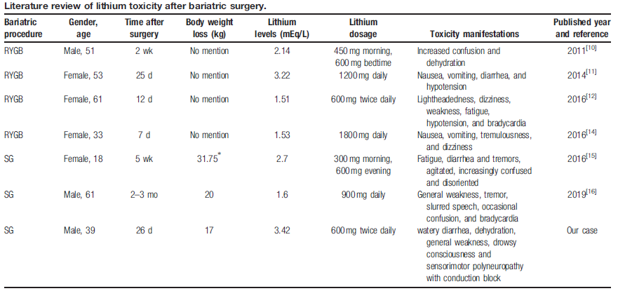
Stabilizzatori dell’umore: litio
Notes:
‘’Lithium toxicity with prolonged neurologic sequelae following sleeve gastrectomy’’

Slide 21
Stabilizzatori dell’umore: litio
1. Mantenere la collaborazione tra equipe chirurgica e psichiatrica nelle fasi pre e post operatorie
2.Determinare i livelli di litio preoperatori ed effettuare una valutazione clinica dell'umore con scale di valutazione
3. Educare il paziente sull’importanza di bere almeno tra i 2 e tre L di acqua al giorno
4. Valutare settimanalmente i livelli di litio e il GFR per 6 settimane e successivamente ogni 2 settimane fino a 6 mesi dopo l’intervento. Dopodiché richiedere la litiemia mensilmente fino ad 1 anno dall’intervento
Notes:
‘’Lithium toxicity following Roux-en-Y gastric bypass: Mini review and illustrative case’’

Slide 22
Stabilizzatori dell’umore: litio
5. Considerare la riduzione del dosaggio se la litiemia supera del 25% i livelli di litio pre operatori
6. Per prevenire la disidratazione, consigliare al paziente di avvisare il proprio medico o psichiatra in caso di qualsiasi cambiamento nell'assunzione di cibo, liquidi o in caso di vomito grave.

Slide 23
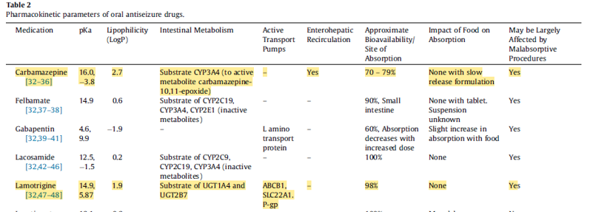
Stabilizzatori dell’umore: antiepilettici
Dott. - nome conf - data
Notes:
‘’Antiseizure Medication use in Gastric Bypass Patients and Other Post-Surgical Malabsorptive States’’
Others mood stabilizer could be an alternative to lithium.
This review evaluate the pharmacokinetcis alterations of common ASM after various gastric bypass procedures and malabsorpitive states. Some of these drugs are often used as mood stabiilizers,
Based on these drugs properties only topiramate in the antiepilectic class have fewer issues referable to absorption related to bariatric surgery while oral formulations of carbamazepine, lamotrigine and valproic acid have reduced absorption due to effects of bariatric surgery based on the pharmacokinetic properties of these medications.
These results have been also confirmed in other studies….

Slide 24
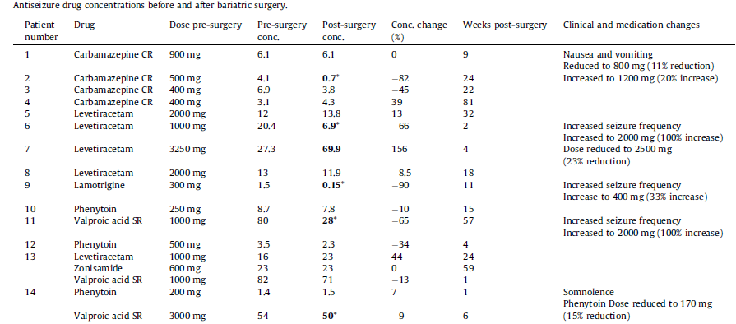
Stabilizzatori dell’umore: antiepilettici
Notes:
‘’The effect of weight reduction surgery on the efficacy and tolerability of epilepsy pharmacotherapy’’
One study evaluated the effect of bariatric surgery on tolerability and efficacy of antiepilecthis drugs (The majority of patients in this series underwent a biliopancreatic diversion, or Roux-en-Y) showing reduced serum concentrations of lamotrigine, valproate, carabamazepine after the procedure
ASD toxicity occurred in 11% of patients prescribed ASD in the first 6 months following bariatric surgery, including hyperammonemic encephalopathy secondary to valproate in the setting of significant weight loss, a previously described complication

Slide 25
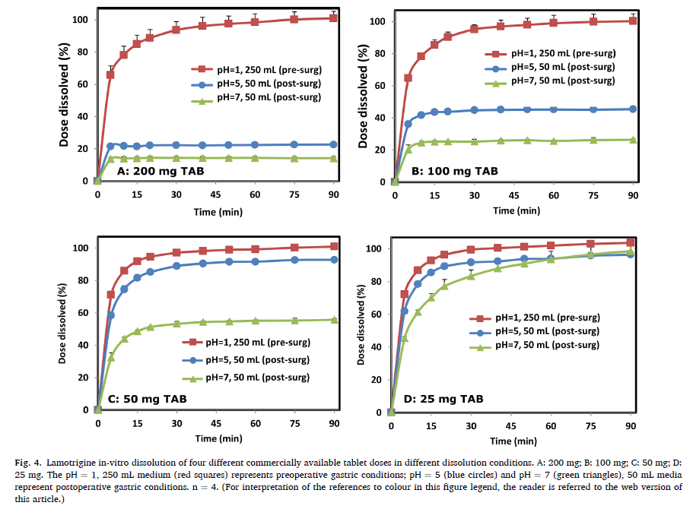
Stabilizzatori dell’umore: antiepilettici
In questo studio in vitro si evidenzia una bassa e insufficiente solubilità della lamotrigina
Dimezzando la dose, raddoppia la percentuale di farmaco dissolto, quindi per superare i problemi di dissoluzione/solubilità i pazienti potrebbero beneficiare dalla divisione della dose giornaliera
Notes:
‘’Lamotrigine therapy in patients after bariatric surgery: Potentially hampered solubility and dissolution’’
Lamotrigine is a major weight neutral drug and is among the most common medications around the world, frequently prescribed among patients with obesity, both before and after bariatric surgery. Yet, various drug characteristics make lamotrigine use challenging after these operations.
Among the bariatric patients, over 75% are females, and the average age of the operated patient is 42, so many of these patients are of childbearing potential, therefore, the use of lamotrigine could be an optimal alternative for valproate , which is know to be highly teratogenic ( and also weight gaining ).
This study evaluated the solubility and dissolution of lamotrigine in in vitro and ex vivo using different ph. This is necessary as the gastric ph could vary after different types of bariatric surgery. ( in SG is around 5) the drug’s solubility is expected to be pH-dependent and alterations in the acidic gastric conditions after the surgery may be a key factor determining lamotrigine oral exposure. As the images show lamotrigine saturation solubility decreases with increasing pH.
Patient may benefit from splitting the daily dose(For example, a patient who used to ingest 100 mg lamotrigine once daily before surgery may be moved to a postoperative dose regimen of 50 mg, twice daily ( 2)
Tablet crushing and drug powder spreading onto food is recommended in guidelines for drug administration in the months following bariatric surgery. This approach prevents the need for swallowing and also bypasses the stomach disintegration stage, which may be hampered after surgery due to insufficien volume, contractility and acid release
Lower doses were already reaching complete dissolution in addition, but in this study tablet crushing did not improve the release of
lamotrigine in pH = 7. Under these conditions, lamotrigine solubility is poor, and tablet crushing is insufficient to overcome this. To note, even
when dissolution is enhanced by tablet crushing, it is likely to still be incomplete, suggesting that drug dissolution limitations demand serious
consideration by formulators and clinicians
A case report of a 47 years old male who was prevoulsy treated with phenobarbitone, suffered of seizure after an RYGB . Initially phenytoin was added but then he had another seizure so lamotrigine was added instead of phenytoin. The serum concentration of lamotrigine have been therapeutic in the following controls. He did not suffer of other seizure
(

Slide 26
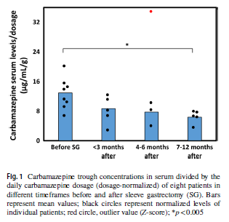
Stabilizzatori dell’umore: antiepilettici
Da otto pazienti trattati con SG e in terapia con carbamazepina per diverse indicazioni questo studio ha mostrato una:
-riduzione della concentrazione di CBZ in 4 pazienti
- Un incremento della concentrazione in 1 paziente
Notes:
‘’Carbamazepine Therapy After Bariatric Surgery: Eight Sleeve Gastrectomy Cases and Review of the Literature’’
These results suggest that the pharmacokinetics of CBZ may be affected by SG. Following SG, significant gastrointestinal hanges affect key parameters including intra-gastric volume, pH, and gastric emptying time. During this procedure, 80% of the stomach volume is removed, leavingonly 1/5 of the original stomach volume available for disintegration/
dissolution of the drug from its solid oral dosageform. Gastric half-emptying time decreases potentially limiting the extent of intra-gastric drug disintegration and dissolution. Furthermore, intra-gastric pH increases after SG All of the above may limit the extent of drug dissolution, a primary and necessary step in the process of oral drug absorption.
The solubility/dissolution of such drugs is typically low, a barrier that is even more challenging after SG. CBZ is considered a low solubility (18 μg/mL), lipophilic (LogP = 2.5) drug, and is administered at high doses. Meanwhile, given that CBZ is a neutral drug, pH changes are unlikely to play a role.Drug metabolism is another important mechanism in the clearance of drugs that may be influenced by SG. Shortly after SG, significant weight loss is achieved, possibly affecting the activity of drug-metabolizing enzymes. CytochromeP450 3A4 (CYP3A4) is involved in the clearance of more drugs than any other enzyme, and its activity may decrease among patients with obesity, with SG shown to normalize
the CYP3A4 activity [15]. Since CBZ is predominantly metabolized by CYP3A4, low activity in obesity may result in high CBZ levels, while after SG and normalization of the
enzymatic activity, CBZ levels may decrease.. Hampered dissolution resulting in incomplete absorption, potentially
supported by enhanced elimination of the drug dose, will decrease the serum drug levels, and likely also the trough
levels. Interestingly, the lowest CBZ levels recorded were in the timeframe of 7–12 months post-SG, when maximal weight loss is typically reached. This trend of decreased
CBZ levels over time after SG may be attributable to hampered drug dissolution, supported by weight-related normalization of CYP3A4 activity. In cases of hampered dissolution,
increasing the drug dose is not expected to provide much benefit, given the solubility barrie

Slide 27
Antipsicotici
Notes:
‘’Dissolution of Common Psychiatric Medications in a Roux-en-Y Gastric Bypass Model’’
In vitro dissolution study ( simulating RGYB ) Clozapine, olanzapine, quetiapine, risperidone, and ziprasidone had greater dissolution in the control condition
The dissolution of haloperidol did not vary. This data was also confirmed by a case report study- which described a schizophrenic patients treated with 20 mg haloperidol who underwent to a gastric bypass procedure. In this case report the the steady state plasma concentrations after the surgery were in range ( 15 to 30 ng/ml ) suggesting that extensive abosrbtion occured. This demonstrated that no parhamocokinetis abrnomalities interfierred with absorbtion

Slide 28
Antipsicotici
Clozapina, olanzapina, quetiapina, risperidone, and ziprasidone hanno una maggiore dissoluzione nei controlli
La dissoluzione dell’aloperidolo non varia
In un case-report le concentrazioni di aloperidolo erano nel range terapeutico sia prima che dopo RYGB
Notes:
‘’Dissolution of Common Psychiatric Medications in a Roux-en-Y Gastric Bypass Model’’
In vitro dissolution study ( simulating RGYB ) Clozapine, olanzapine, quetiapine, risperidone, and ziprasidone had greater dissolution in the control condition
The dissolution of haloperidol did not vary. This data was also confirmed by a case report study- which described a schizophrenic patients treated with 20 mg haloperidol who underwent to a gastric bypass procedure. In this case report the the steady state plasma concentrations after the surgery were in range ( 15 to 30 ng/ml ) suggesting that extensive abosrbtion occured. This demonstrated that no parhamocokinetis abrnomalities interfierred with absorbtion

Slide 29
Effetto dei farmaci sul peso
La maggior parte degli studi non hanno mostrato un significativo impatto degli antidepressivi sulla perdita di peso dopo RYGB
L'unico studio che ha mostrato riduzioni significative nella perdita di peso con il trattamento antidepressivo aveva basse percentuali di trattamento antidepressivo nel campione (16%) e ha mostrato un maggiore aumento di peso con SNRI e antidepressivi triciclici.
Notes:
Most studies showed no significant impact of antidepressants on weight loss after RYGBS up to 1 year after surgery
The only study showing significant reductions in weight loss outcomes with antidepressant treatment had low rates of antidepressant treatment in the sample (16%) and also showed greater weight gain with SNRIs and tricyclic antidepressants
this finding contrasts results from the only prospective study that showed that SSRI treatment was associated with significantly lower weight loss than SNRI treatmen
Psychiatric Management of Bariatric Surgery Patients: A Review of Psychopharmacological and Psychological Treatments and Their Impact on Postoperative Mental Health andWeightOutcomes)

Slide 30
Effetto dei farmaci sul peso
Questi risultati preliminari suggeriscono che la terapia antidepressiva in generale potrebbe non influenzare la perdita di peso a 1 anno dopo l'intervento chirurgico
I dati prospettici mostrano anche che i pazienti che assumono uno o più farmaci psichiatrici dopo l'intervento chirurgico non hanno avuto risultati significativamente diversi nella perdita di peso rispetto ai pazienti che non assumono farmaci psichiatrici
Questi risultati sono ulteriormente supportati da uno studio che non ha riscontrato differenze significative nella perdita di peso ad 1 anno tra pazienti senza malattie psichiatriche, con malattie psichiatriche complesse e altre malattie psichiatriche
Notes:
These preliminary findings suggest that antidepressant therapy generally may not impact weight loss at 1 year after surgery, although further data are needed to clarify differential effects among antidepressant classes.
Prospective data also show that patients on 1 or more psychiatric medications after surgery did not have significantly different weight loss outcomes compared with patients not on psychiatric medications.
These findings are further supported by a study showing no significant difference in 1-year outcomes for weight loss and health-related quality of life between patients with no psychiatric illness, complex psychiatric illness (severe illness or past suicide attempt), and other psychiatric illnesses.
This suggest that general psychopharmacological treatment does not influence weight loss outcomes after surgeryand that psychiatric stability is more critical to durable
weight loss outcomes
(PsychiatricManagement of Bariatric Surgery Patients: A Review of Psychopharmacological and Psychological Treatments and Their Impact onPostoperative Mental Health andWeightOutcomes)

Slide 31
Effetto dei farmaci sul peso
I farmaci antipsicotici di seconda generazione, che presentano un rischio variabile di disturbi metabolici e aumento di peso, possono essere prescritti dopo la chirurgia bariatrica
Quando si considerano questi farmaci, è necessario prestare particolare attenzione alle indicazioni per il loro uso, al profilo metabolico, alla disponibilità di formulazioni alternative in caso di scarsa tolleranza orale o sospetto malassorbimento.
In un case-report si è utilizzato con successo un farmaco long-acting dopo la chirurgia bariatrica che quindi potrebbe rappresentare una valida opzione in alcuni pazienti.
Notes:
Although no studies specifically examined the effects of antipsychotic medications on weight loss outcomes, it is important to consider their potential effects. Second-generation antipsychotics, which have a variable risk of metabolic disturbances and weight gain, may be prescribed after bariatric surgery given their expanding clinical indications and evidence suggesting that patients with major mental illness have comparable bariatric surgery outcomes as controls. When considering patients stabilized on these medications, special attention should be placed on the indications for their use, history of past trials of similar medications, the metabolic profile of the specific agents, the availability of alternative formulations in case of poor oral tolerance or suspected malabsorption, and kilocalorie congestion requirements with certain medications. There is a successful report of using a long-acting injectable43 after bariatric surgery which could serve as an option in some patient presentations.
(PsychiatricManagement of Bariatric Surgery Patients: A Review of Psychopharmacological and Psychological Treatments and Their Impact onPostoperative Mental Health andWeightOutcomes

Slide 32
Grazie

